Slide 1
A secure video transmission framework over wireless networks
2016. 5.
Kyungmin Go, Sungwon Kang and Myungchul Kim
School of Computing, KAIST
Notes:
Transformation of Encoded Video Packets for Error-Resilient Transmission

Slide 2
CONTENTS
Introduction
Background
Related Work
Proposed Framework
Evaluation Result
Conclusion

Slide 3
1. Introduction
Two major issues
- Two major issues of real-time multimedia services through Wi-Fi.
Video quality degradation
- Available network bandwidth, error-resilient video transmission
Secure video transmission
- Encrypted video transmission
Notes:
Extended
두 가지 주요 이슈가 있다.

Slide 4
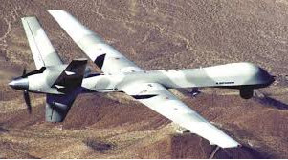
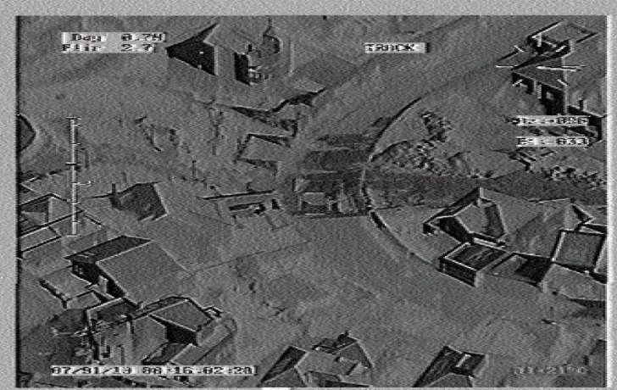
1. Introduction
Secure video transmission
- Secure video transmission from various video sensors is critical issue to protect privacy and public safety.
- Eavesdropping of transmitted video ^{[25]}
Transmitted video can be illegally monitored and acquired on wireless transmission through cyber-attacks like an eavesdropping.
e.g. Surveillance video transmitted from Military UAV is eavesdropped in Iraqi ^{[22]}.
*. UAV: Unmanned aerial vehicle
Notes:
Extension
군용 통신에서도 eavesdropping 되는데, broadcast 가 기본인 Wi-Fi 에서는 더 문제 시 될 수 있음.

Slide 5
1. Introduction
Secure video transmission (cont.)
- Possible approaches
Fully-encrypted video transmission.
- Encrypt entire recorded video with advanced encryption standard (AES).
- Encryption overheads like battery and computing power consumption are proportion to recorded video size.
Selectively encrypted video transmission.
Selectively encrypt the critical video data to reduce encryption overheads.
Representative methods ^{[23][24]}.
Joint compression and encryption schemes.
Compression independent encryption schemes.
Notes:
Extension

Slide 6
1. Introduction
Problem statement (cont.)
- Limitations of conventional selectively encrypted video transmission schemes.
Low transmission security.
The transmission security of the selective encryption schemes is lower than that of the fully-encrypted transmission scheme ^{[23]}.
A portion of the critical video data remains unencrypted.
e.g. Apple’s HTTP Live Streaming (HLS) does not encrypt the H.264/AVC network abstraction layer (NAL) header to identify the encrypted part of recorded video in the video client ^{[26]}.
No adaptive encryption of recorded video.
Video sensors have various levels of computing power according to their purposes and cost limitations.
No selective encryptions schemes have been proposed to adaptively encrypt recorded video by considering both the level of computing power and the critical video data.
Notes:
선별적 암호화 전송 기법
Extension
No adaptive encryption
- 암호화에는 부하가 걸리게 되므로, 시스템의 필요에 따라 이를 조절하는 것은 중요하다.

Slide 7
1. Introduction
Contributions (cont.)
- A secure and error-resilient video transmission framework over wireless networks
Enhanced transmission security of recorded video.
Encrypts all critical video data through per-packet basis that the conventional selectively encrypted video transmission schemes have not encrypted.
e.g. H.264/AVC NAL header, MPEG-2 TS header information
Encrypts less amount of recorded video than the conventional schemes.
Enhances the transmission security of both the critical video data and the noncritical video data through the scrambling of the critical video data.
Adaptive encryption of the critical video data.
Adaptively encrypts the critical video data by considering currently available computing power.
Notes:
Extension
through per IP packet basis encryption
Secure video transmission 측면에서

Slide 8
2. Related Work - prioritized video transmission schemes
Header information identification of encoded video after encoding
- Advantages
Codec engine independent approach.
Low overhead to identify the critical video data after encoding.
- Disadvantage
VFPS cannot assign high priority to metadata because its unit of prioritization is video frame.

Slide 9
2. Related Work - selective video encryption schemes
Selective video encryption schemes
- Two classifications based on the timing of encryption ^{[23]}.
Joint compression and encryption schemes ^{[27-29]}
Compression independent encryption schemes ^{[30-32]}
Notes:
According to the surveys of video encryption schemes [8][22]

Slide 10
2. Related Work - selective video encryption schemes
Joint compression and encryption schemes ^{[27-29]}
- Selective video encryption during the video compression with the direct analysis of video encoding variables and parameters
e.g. motion vector, quantization parameters, and coefficient.
- Advantage :
An elaborate encryption is possible due to the direct analysis.
- Disadvantage :
Requires the modification of existing video compression modules.
e.g. Difficult to implement on video sensors that have hardware-compression encoding modules or use commercial video compression software.
Notes:
Extension
[27] A encryption method for H.264, which encrypts only the DC/ACs coefficients of I-macroblocks and the motion vectors of P-macroblocks.
The proposed new selective encryption method exploits the error propagation property in an H.264 decoder and improves the collective performance by analyzing the tradeoff between the visual security level and the processing speed
compared to typical selective encryption methods (i.e., I-frame, P-frame encryption, and combined I-/P-frame encryption).
[28] This work presents a thorough investigation of HEVC-CABAC from an encryption standpoint. An algorithm is devised for conversion of non-dyadic ES to dyadic, which can be concatenated to form plaintext for AES-CFB. For selectively encrypted binstrings, the context of truncated rice code for binarization of future syntax elements is guaranteed to remain unchanged.
[29] we propose the selective encryption algorithm of motion vector based on S-Box to remove the vulnerabilities of the existing selective algorithms.
S-Box is a set of results created by a certain expression or algorithm, which substitutes and transforms data based on these results. S-Box used to increase confidentiality in substitution stage of some encryption
algorithm. In particular, in the AES and DES, the substitution process by S-Box plays an important role to ensure confidentiality.

Slide 11
2. Related Work - selective video encryption schemes
Compression independent encryption schemes ^{[30-32]}
- Selective video encryption after the video compression.
- Advantage :
Encrypt recorded video independent of compression, therefore no modification is required to existing video compression modules.
- Disadvantages :
Encrypt the critical video data based on information that is less elaborate than that of joint compression and encryption schemes.
e.g. H.264/AVC NAL header information.
The encrypted percentage of recorded video is significantly higher than that of joint compression and encryption schemes.
Notes:
Extension
[30] Puzzle, partitions a video frame with a number of data blocks and reorders the divided blocks. After partitioning a video frame, a portion of the target ciphertext is selectively encrypted with two primitive operations: XOR and integer addition
[31] SECMPEG, Meyer and Gadegast defined four security levels by determining the subset of MPEG-1 recorded video to encrypt. In the lowest level 1, only headers that contain standardized information are encrypted while the whole MPEG-1 recorded video is encrypted in the highest level 4
[32] Spanos and Maples encrypted all the I-frames of MPEG-1 recorded video

Slide 12
3. Proposed Framework
Proposed Framework
A secure and error-resilient video transmission framework over wireless networks.
Identification and reallocation of the critical video data with the unit of MPEG-2 TS packet (Size : 188 bytes).
Secure and prioritized transmission of reallocated packets with the unit of IP packet (MTU: 1,200 bytes) that can contain six MPEG-2 TS packets at a time.
The proposed framework consists of following steps :
Step 1) Identification of the critical video data
Step 2) Reallocation of the critical video packets
Step 3) Secure and prioritized transmission of video packets
Step 3-1) Prioritized transmission of video packets
Step 3-2) Secure transmission of video packets
Step 4) Restoration of transmitted video packets
Notes:
Revised - 9

Slide 13
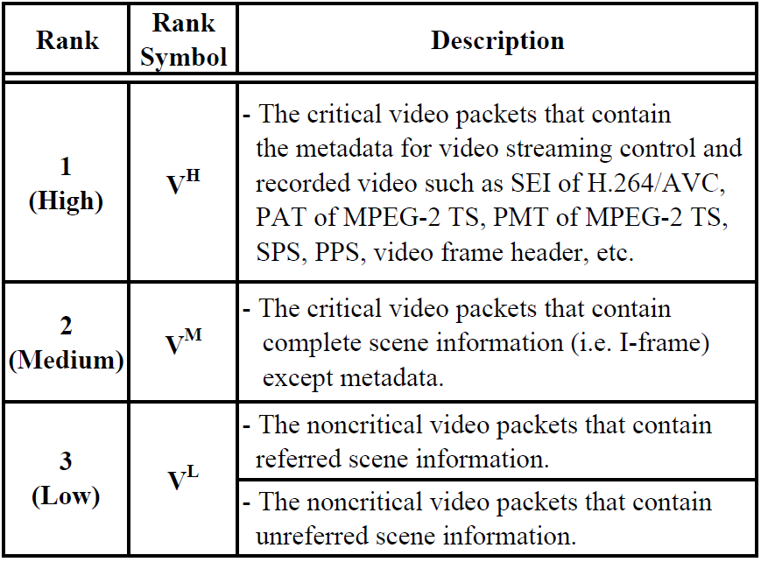
3. Proposed Framework
Step 3-2) Secure transmission of video packets
- Adaptive encryption of the critical video packets.
- Classify video packets with three categories such as high (V^{H}), medium (V^{M}), and low (V^{L}).
- Depend on currently available computing power, V^{H}, V^{M}, and V^{L} are selectively encrypted and transmitted through SSL.
Currently available computing power
100%
High threshold
(x %)
Encrypt V^{H}, V^{M}, and V^{L}
Encrypt V^{H} and V^{M}
Low
threshold
(y %)
Encrypt V^{H}
0%
Notes:
Extension
개별 모듈.

Slide 14
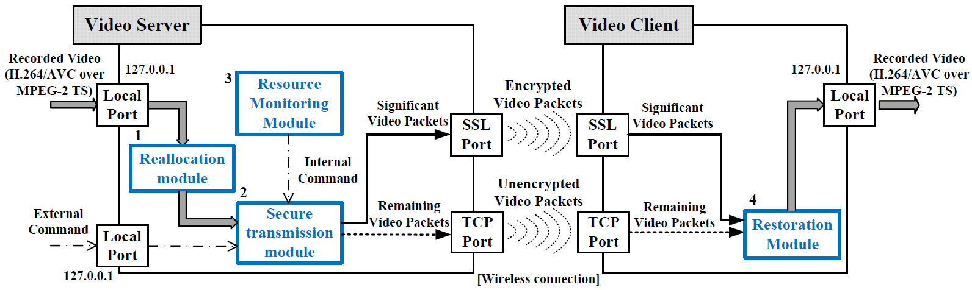
4. Evaluation Result
Evaluation environment 2 - secure video transmission
- Developed a video sensor using Raspberry Pi that can be mounted on the AR.Drone through external USB port.
- Compare the performances between the proposed framework and fully-encrypted transmission scheme.
- Criteria: The number of encrypted video packets, battery power consumption, and transmission security.
Notes:
Extension

Slide 15
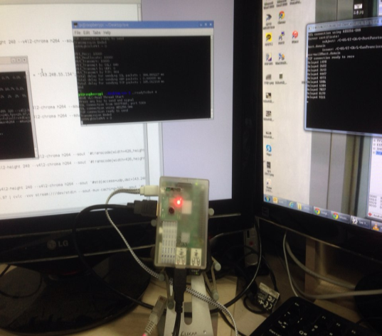
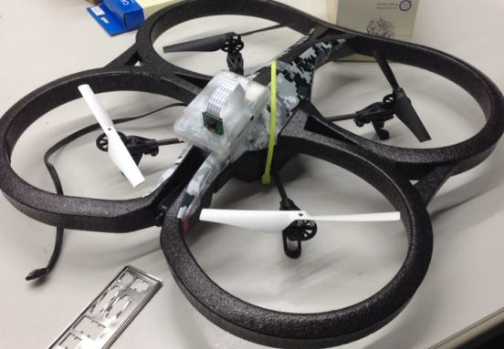
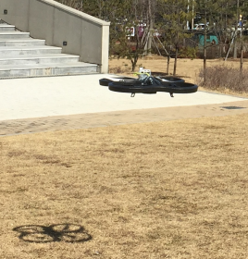
4. Evaluation Result
Evaluation environment 2 - secure video transmission (cont.)
- Developed a video sensor using Raspberry Pi that can be mounted on the AR.Drone through external USB port.
- Compare the performances between the proposed framework and fully-encrypted transmission scheme.
- Criteria: The number of encrypted video packets, battery power consumption, and transmission security.
Video sensor
Mounted video sensor
Flight
Notes:
Extension

Slide 16
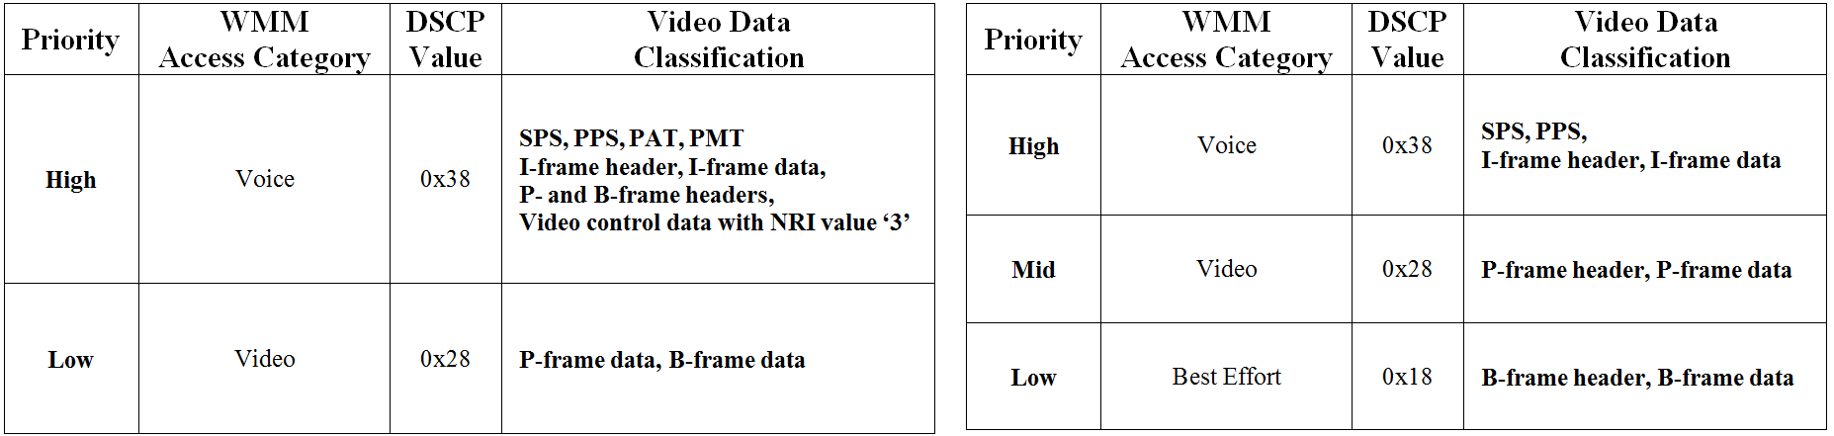
4. Evaluation Result
Evaluation on prioritized video transmission
- The proposed framework transmits recorded video with high and low priorities on a per IP packet basis after reallocation.
- VFPS transmits recorded video with high, middle, and low priorities on a per video frame basis.
Proposed framework
VFPS
*. VFPS: video frame prioritization schemes
Notes:
Revised - 4

Slide 17
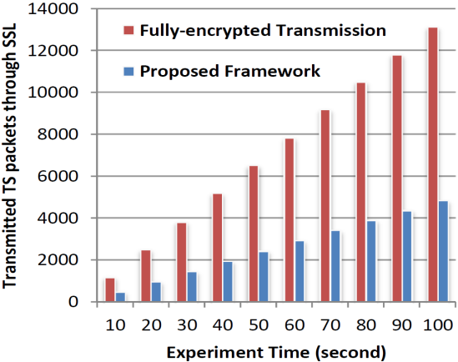
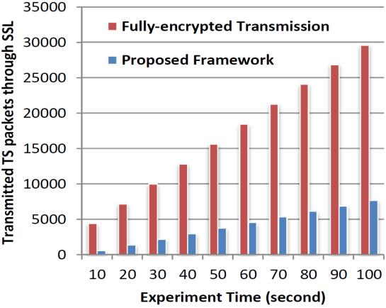
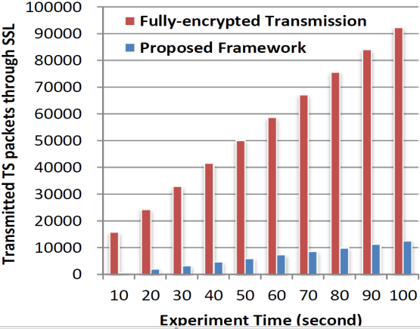
4. Evaluation Result
Evaluation on secure video transmission - encrypted video packets
- The proposed framework transmits significantly less number of video packets through encrypted transmission than fully-encrypted transmission scheme.
(a) 426x240 (b) 640x360 (c) 854x480
Accumulated amount of transmitted TS packets through SSL
for three different video resolutions
Notes:
Extension

Slide 18
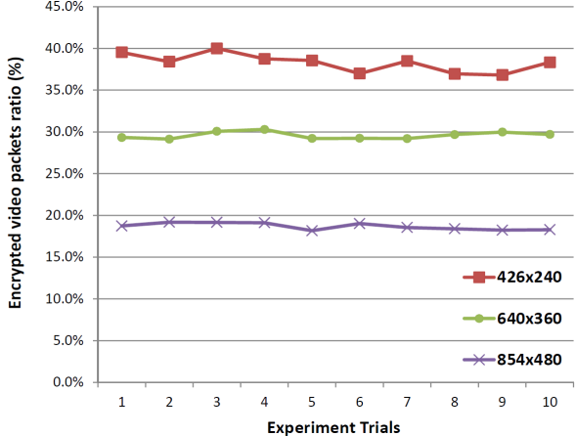
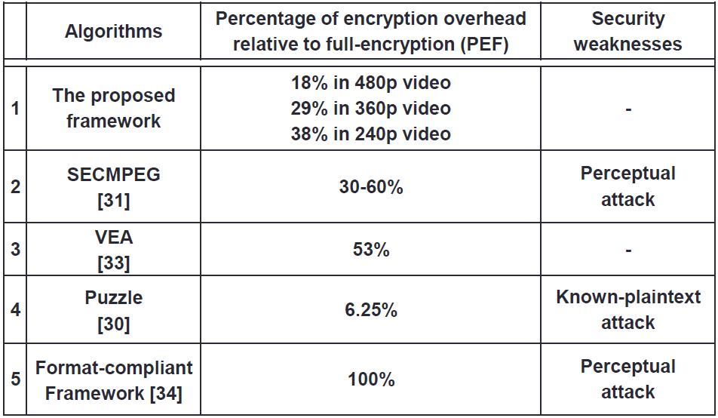
4. Evaluation Result
Evaluation on secure video transmission - encrypted video packets (cont.)
- The proposed framework transmits significantly less number of video packets than previous compression independent encryption schemes that use AES.
Encrypted video packets ratios
of three different video resolutions
Percentage of encryption overhead relative to full-encryption [23]
*. AES: advanced encryption standard
Notes:
Extension

Slide 19
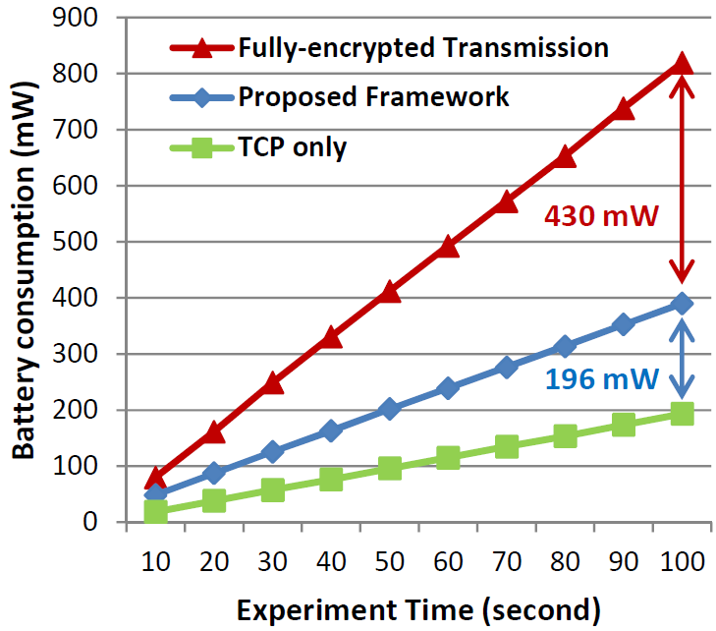
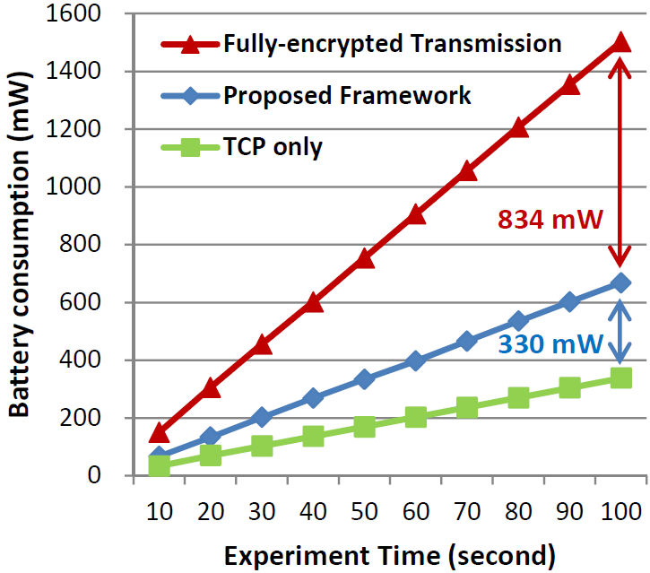
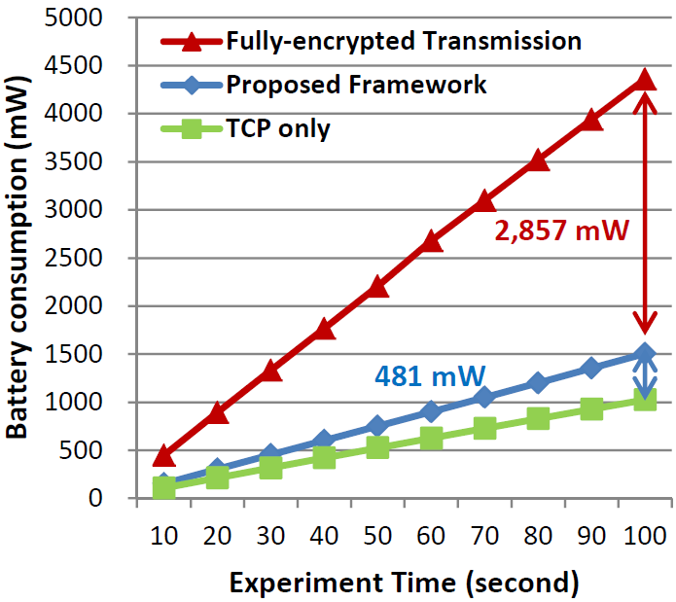
4. Evaluation Result
Evaluation on secure video transmission - battery power consumption.
- The proposed framework consumes significantly less battery powers to transmit video packets than fully-encrypted transmission scheme.
(a) 426x240 (b) 640x360 (c) 854x480
Accumulated battery power consumptions for three different video resolutions
Notes:
Extension

Slide 20
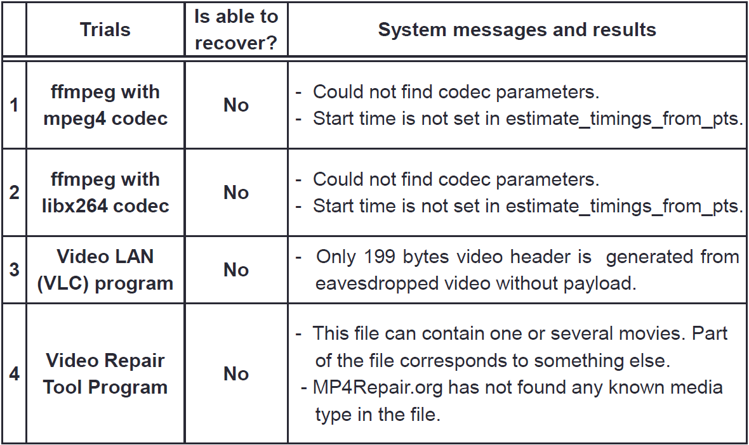
4. Evaluation Result
Evaluation on secure video transmission - transmission security
- The noncritical video packets cannot be decoded with video codecs and recovered by recovery tool even if the packets are not transmitted with encryption.
Notes:
Extension

Slide 21
5. Conclusion
The proposed framework provides enhanced video transmission security with less amounts of transmitted packets and battery power consumption than the fully-encrypted transmission scheme through adaptive encryption.
The proposed framework can be used to provide a secure and error-resilient transmission of video packets on high-end devices such as UAV and virtual reality (VD) devices, and 3D video camera.
*. UAV: Unmanned aerial vehicle
Notes:
the proposed framework provides an enhanced video transmission security with less than half of the battery power consumption required by the fully-encrypted transmission of recorded video

Slide 22
REFERENCES (1/5)
[1] Cisco. Cisco visual networking Index: Global mobile data traffic forecast update 2013–2018, 2014.
[2] T. Wiegand and B. Girod, “Multi-frame motion-compensated prediction for video transmission,” Springer Science & Business Media, 636, 2012.
[3] J. Greengrass, J. Evans, and A. C. Begen, “Not all packets are equal part II: The impact of network packet loss on video quality,” IEEE Internet Computing. 13, 2, 74-82, 2009.
[4] Objective video quality evaluation and H.264/SVC content streaming over WLANs, http://access.feld.cvut.cz/view.php?cisloclanku=2013010001.
[5] A. Talari, S. Kumar, N. Rahnavard, S. Paluri, and J.D. Matyjas, “Optimized cross-layer forward error correction coding for H. 264 AVC video transmission over wireless channels,” EURASIP Journal on Wireless Communications and Networking, 1, 1-13, 2013.
[6] K.K. Kambhatla, S. Paluri, J.D. Matyjas, and S. Kumar, “Cross-Layer prioritized H. 264 video packetization and error protection over noisy channels,” Springer Multimedia Tools and Applications, published online, 1-23, 2015.
[7] E. Baccaglini, G. Marchetto, T. Tillo, and G. Olmo, “Efficient slice‐aware H. 264/AVC video transmission over time‐driven priority networks,” Wiley International Journal of Communication Systems, 27, 12, 3822-3836, 2014.
[8] S. K. Srinivasan, J. Vahabzadeh-Hagh, and M. Reisslein, “The effects of priority levels and buffering on the statistical multiplexing of single-layer H.264/AVC and SVC encoded video streams,” IEEE Transactions on Broadcasting. 56, 3, 281-287, 2010.

Slide 23
REFERENCES (2/5)
[9] E. Haghani, S. Parekh, D. Calin, E. Kim, and N. Ansari, “A quality-driven cross-layer solution for MPEG video streaming over WiMAX networks,” IEEE Transactions on Multimedia. 11, 6, 1140-1147, 2009.
[10] C.H. Ke, K.W. Lin, C.A. Huang, Y.S. Chen, and S.O. Park, “Cross-layer quality enhancement scheme for video transmission over multi-hop wireless networks,” Springer Multimedia Tools and Applications, published online, 1-17, 2015.
[11] X.W. Yao, W.L. Wang, S.H. Yang, Y.F. Cen, X.M. Yao, and T.Q. Pan, “Ipb-frame adaptive mapping mechanism for video transmission over IEEE 802.11 e WLANs,” ACM SIGCOMM Computer Communication Review, 44, 2, 5-12, 2014.
[12] H. Wang and G. Liu, “Priority and delay aware packet management framework for real-time video transport over 802.11e WLANs,” Springer Multimedia Tools and Applications. 69, 3, 621-641, 2014.
[13] S. Nazir, D. Vukobratović, V. Stanković, I. Andonović, K. Nybom, and S. Grönroos, “Unequal error protection for data partitioned H. 264/AVC video broadcasting,” Springer Multimedia Tools and Applications, published online, 1-23, 2014.
[14] P. F. Yaser, N. Panos, and A. Hussein, “Efficient transmission of H.264 video over multirate IEEE 802.11e WLANs,” EURASIP Journal on Wireless Communications and Networking, 11, 2008.
[15] N. Feng and Y. Chang, “Unequal loss protection for H. 264/AVC video streaming over wireless networks,” Springer Journal of Signal Processing Systems, 78, 2, 115-121, 2015.

Slide 24
REFERENCES (3/5)
[16] S. Paluri, K.K. Kambhatla, B.A. Bailey, P.C. Cosman, J.D. Matyjas, and S. Kumar, “A low complexity model for predicting slice loss distortion for prioritizing H. 264/AVC video,” Springer Multimedia Tools and Applications, published online, 1-25, 2014.
[17] A. Ksentini, M. Naimi, and A. Gueroui, “Toward an improvement of H.264 video transmission over IEEE 802.11e through a cross-layer architecture,” IEEE Communications Magazine. 44, 1, 107-114, 2006.
[18] Mathias Wien, “High Efficiency Video Coding: Coding Tools and Specification,” Springer Verlag, 2014.
[19] Wi-Fi Alliance, “Wi-Fi CERTIFIED for WMM-support for Multimedia applications with QoS in Wi-Fi,” 2004.
[20] Xiph.Org Foundation. http://media.xiph.org/video/derf/.
[21] Youtube live streaming guide. https://support.google.com/youtube/answer/2853702?hl=en&ref_topic=2853713.
[22] The Wall Street Journal, Insurgents Hack U.S. Drones, http://www.wsj.com/articles/SB126102247889095011.
[23] F. Liu and H. Koenig, "A survey of video encryption algorithms," Computers & Security, 29, 1, 3-15, 2010.
[24] A. Massoudi, F. Lefebvre, C. De Vleeschouwer, B. Macq, and J.J. Quisquater, "Overview on selective encryption of image and video: challenges and perspectives," EURASIP Journal on Information Security, 5, 2008.
[25] G. Fehér and I. Oláh, "Enhancing wireless video streaming using lightweight approximate authentication," Multimedia Systems, 14, 3, 167-177, 2008.
[26] Apple, MPEG-2 Stream Encryption Format for HTTP Live Streaming, https://developer.apple.com/ library/prerelease/ios/documentation/AudioVideo/Conceptual/HLS_Sample_Encryption/Encryption/Encryption.html

Slide 25
REFERENCES (4/5)
[27] Y. Chung, S. Lee, T. Jeon, and D. Park, "Fast video encryption using the H. 264 error propagation property for smart mobile devices," Sensors, 15, 4, 7953-7968, 2015.
[28] Z. Shahid and W. Puech, "Visual protection of HEVC video by selective encryption of CABAC binstrings," IEEE Transactions on Multimedia, 16, 1, 24-36, 2014.
[29] S.S. Hong and M.M. Han, "The study of selective encryption of motion vector based on the S-Box for the security improvement in the process of video," Multimedia tools and applications, 71, 3, 1577-1597, 2014.
[30] F. Liu and H. Koenig, "Puzzle-an efficient, compression independent video encryption algorithm," Multimedia Tools and Applications, 73, 2, 715-735, 2014.
[31] J. Meyer and F. Gadegast, "Security mechanisms for multimedia data with the example MPEG-1 video," Project Description of SECMPEG, Technical University of Berlin, Germany, 1995.
[32] G.A. Spanos and T.B. Maples, "Performance study of a selective encryption scheme for the security of networked, real-time video," In Proceedings of the fourth IEEE International Conference on Computer Communications and Networks (ICCCN), 2-10, 1995.
[33] L. Qiao, K. Nahrstedt, and M.C. Tam, "Is MPEG encryption by using random list instead of zigzag order secure?," In Proceedings of IEEE International Symposium on Consumer Electronics (ISCE), 226-229, 1997.
[34] J.G. Wen, M. Severa, W. Zeng, M.H. Luttrell, and W. Jin, "A format-compliant configurable encryption framework for access control of video," IEEE Transactions on Circuits and Systems for Video Technology, 12, 6, 545-557, 2002.

Slide 26
REFERENCES (5/5)
[35] VideoLAN Organization, VideoLAN Client (VLC), http://www.videolan.org/
[36] FFmpeg Project, FFmpeg, http://www.ffmpeg.org/.
[37] MP4repair Organization, MP4repair, http://mp4repair. org /pwt6/preview.html.

